Slide 1
BA-406 Spreadsheet Modeling
Linear Programming: Introduction, Formulation and Graphical Solution

Slide 2
Outline
Definition of Linear Programming
Formulation of Linear Programming
Surviving in an island
Extending a problem formulation
Wyndor Glass Co. Product Mix Problem
Linear Programming Terminology
Graphical Solution to Linear Programming
Properties of Linear Programming

Slide 3
Outline
Definition of Linear Programming
Formulation of Linear Programming
Surviving in an island
Extending a problem formulation
Wyndor Glass Co. Product Mix Problem
Linear Programming Terminology
Graphical Solution to Linear Programming
Properties of Linear Programming

Slide 4
What is Mathematical Programming?
Mathematical programming is selecting the best option(s) from a set of alternatives mathematically
Minimizing/maximizing a function where your alternatives are defined by functions
Many industries use mathematical programming
Supply chain, logistics, and transportation
Health industry, energy industry, finance, airlines
Manufacturing industry, agriculture industry
Education, Military
Operations Research raised with WWII

Slide 5

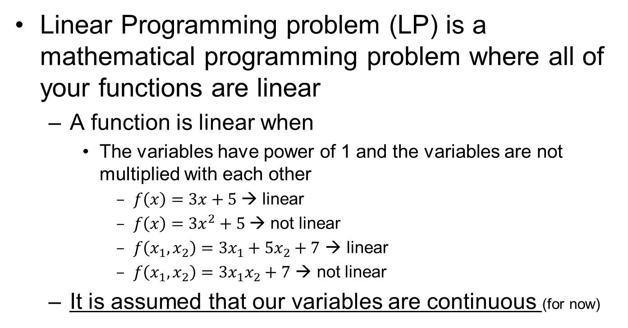

What is Linear Programming?
Linear Programming problem (LP) is a mathematical programming problem where all of your functions are linear
A function is linear when
The variables have power of 1 and the variables are not multiplied with each other
$f\left(x\right)=3x+5$→ linear
$f\left(x\right)=3x^{2}+5$→ not linear
$f\left(x_{1},x_{2}\right)=3x_{1}+5x_{2}+7$ → linear
$f\left(x_{1},x_{2}\right)=3x_{1}x_{2}+7$ → not linear
It is assumed that our variables are continuous (for now)
$$f\left(x\right)$$
$$x$$

Slide 6
Outline
Definition of Linear Programming
Formulation of Linear Programming
Surviving in an island
Extending a problem formulation
Wyndor Glass Co. Product Mix Problem
Linear Programming Terminology
Graphical Solution to Linear Programming
Properties of Linear Programming

Slide 7

How to formulate?
What do we need to formulate a linear programming problem?
Have a problem!!
Know your problem
Gather the relevant data
Know what each number means
Pay attention to the class ☺
Best way to learn is to do some examples….

Slide 8


Example 1: Surviving in an island
Linear programming will save you!
Suppose that you will be left in a deserted island
You want to live as many days as you can to increase chance of rescue
Fortunately (!), you can take a bag with you to the island
What would you put into the bag?

Slide 9
Example 1: Surviving in an island
The bag can carry at most 50 lbs
There are limited set of items you can carry
Bread: You can survive for 2 days with 1 lb of bread
Steak: You can survive for 5 days with 1 lb of steak (Memphis style grilled!)
Chicken: You can survive for 3 days with 1 lb of chicken (southern style deep fried!)
Chocolate: You can survive for 6 days with 1 lb of chocolate
How much of each item to take with you?

Slide 10
Example 1: Formulation Steps
STEP 0: Know the problem and gather your data
Your problem is to increase your chance of rescue by maximizing the number of days you survive
You can have 1 bag which can carry 50 lbs at most
You can only put bread, steak, chicken and chocolate into you bag
Each item enables you survive for a specific number of days for each pound you take
→Bread: 2 days/lb →Steak: 5 days/lb
→Chicken: 3days/lb →Chocolate: 6days/lb

Slide 11
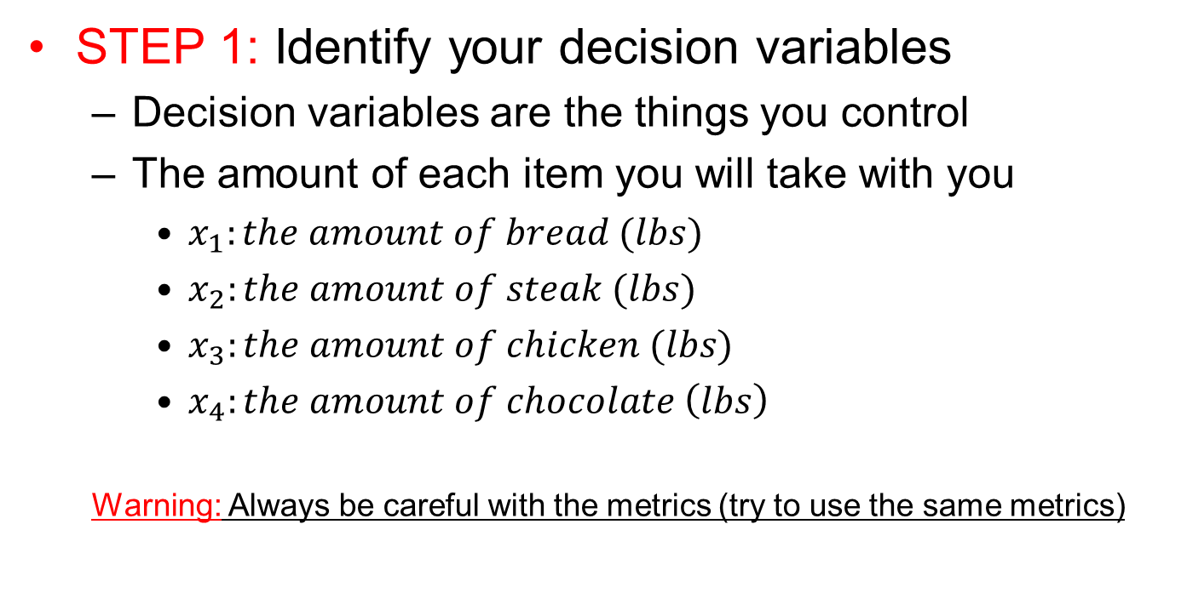
Example 1: Formulation Steps
STEP 1: Identify your decision variables
Decision variables are the things you control
The amount of each item you will take with you
$x_{1}:the amount of bread (lbs)$
$x_{2}:the amount of steak (lbs)$
$x_{3}:the amount of chicken (lbs)$
$x_{4}:the amount of chocolate \left(lbs\right)$
Warning: Always be careful with the metrics (try to use the same metrics)

Slide 12
Example 1: Formulation Steps
STEP 2: Define your objective function and objective
Your objective function is the measure of performance as a result of your decisions
Your objective is what you want to do with your objective function
Recall that you want to maximize the number of days you will survive in the island
Objective
Performance measure
Not a function though

Slide 13

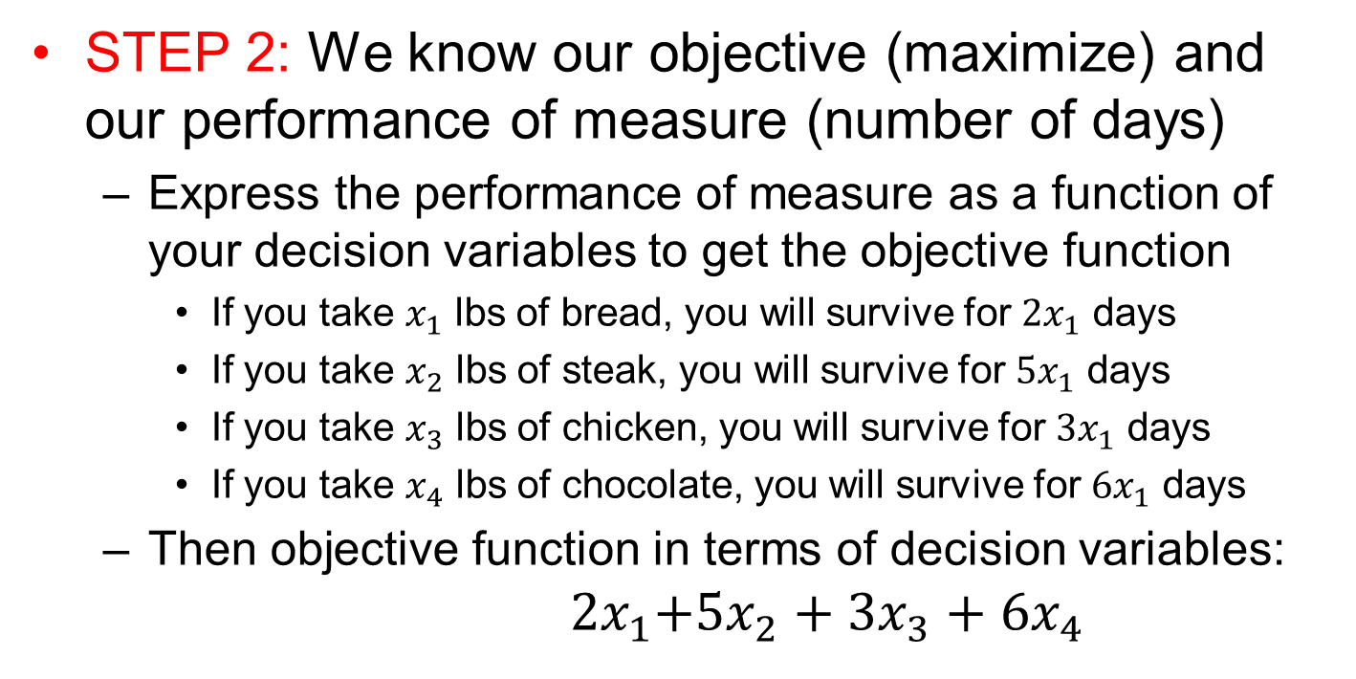
Example 1: Formulation Steps
STEP 2: We know our objective (maximize) and our performance of measure (number of days)
Express the performance of measure as a function of your decision variables to get the objective function
If you take $x_{1}$ lbs of bread, you will survive for ${2x}_{1}$ days
If you take $x_{2}$ lbs of steak, you will survive for ${5x}_{1}$ days
If you take $x_{3}$ lbs of chicken, you will survive for ${3x}_{1}$ days
If you take $x_{4}$ lbs of chocolate, you will survive for ${6x}_{1}$ days
Then objective function in terms of decision variables:
$${ 2x}_{1}+{5x}_{2}+{3x}_{3}+{6x}_{4}$$
$$Maximize$$

Slide 14

Example 1: Formulation Steps
STEP 3: Define your restrictions (constraints)
There may be some restrictions which limit what you can do (hence, they define set of your alternatives)
You can carry 1 bag and it can carry 50 lbs at most
$$x_{1}+x_{2}+x_{3}+x_{4}≤50$$
You cannot get negative amounts!!!
$$x_{1}≥0, x_{2}≥0,x_{3}≥0, x_{4}≥0$$
Limit on how much you can carry
Total amount you
decide to carry

Slide 15

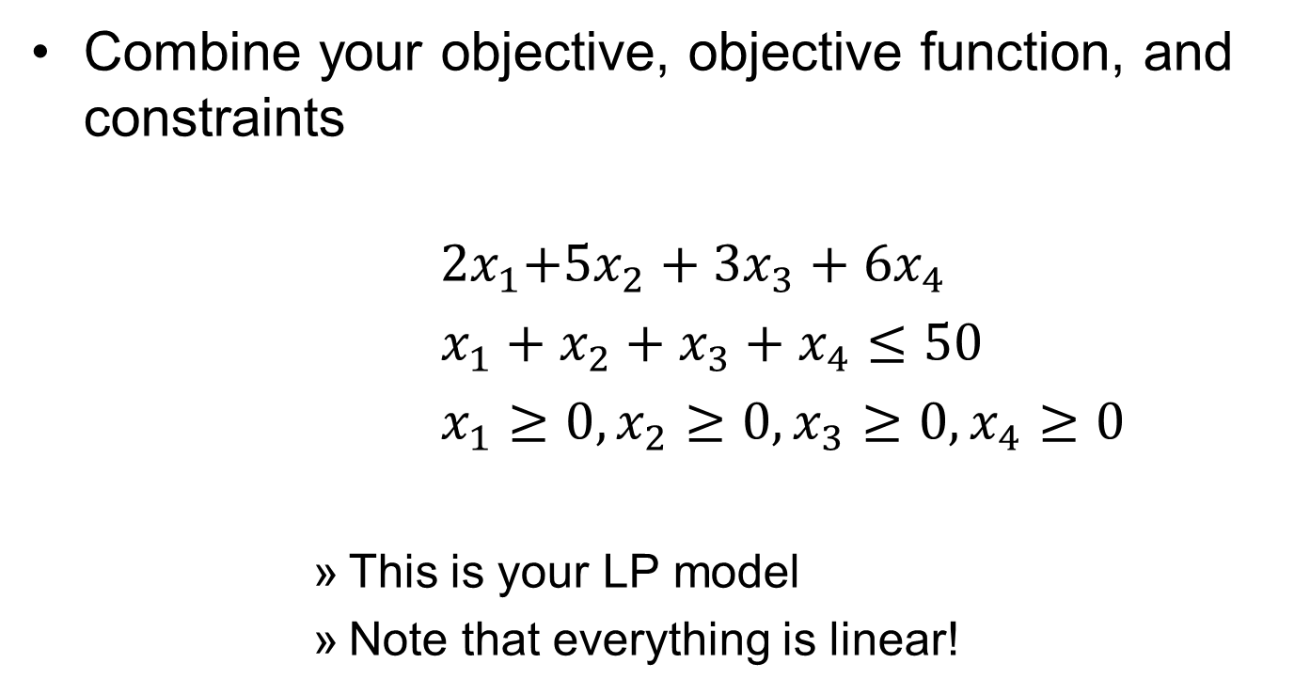

Example 1: LP Formulation
Combine your objective, objective function, and constraints
$${ 2x}_{1}+{5x}_{2}+{3x}_{3}+{6x}_{4}$$
$x_{1}+x_{2}+x_{3}+x_{4}≤50$
$x_{1}≥0, x_{2}≥0,x_{3}≥0, x_{4}≥0$
This is your LP model
Note that everything is linear!
$$Maximize$$
$$subject to$$

Slide 16

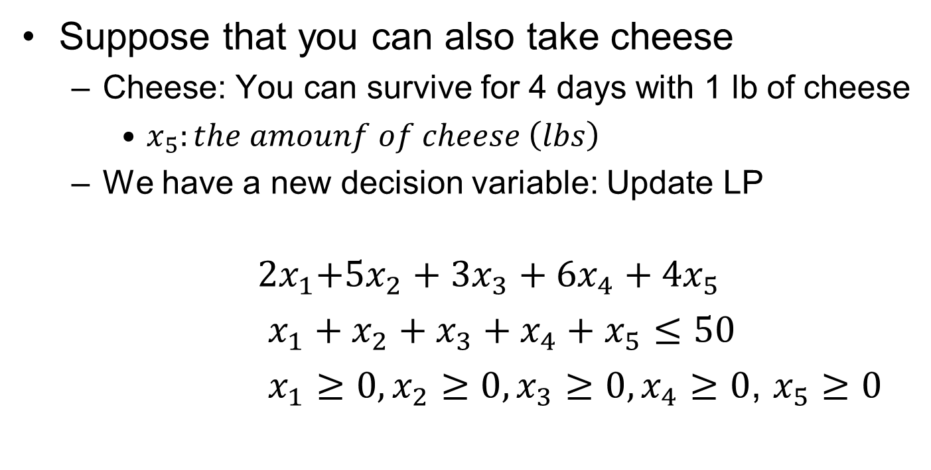

Example 1: Extending the LP
Suppose that you can also take cheese
Cheese: You can survive for 4 days with 1 lb of cheese
$x_{5}:the amounf of cheese \left(lbs\right)$
We have a new decision variable: Update LP
$${ 2x}_{1}+{5x}_{2}+{3x}_{3}+{6x}_{4}+{4x}_{5}$$
$x_{1}+x_{2}+x_{3}+x_{4}+x_{5}≤50$
$x_{1}≥0, x_{2}≥0,x_{3}≥0, x_{4}≥0$, $x_{5}≥0$
$$Maximize$$
$$subject to$$

Slide 17

Example 1: Extending the LP
Furthermore, suppose you have a budgetary limit
1 lb of bread costs you $3
1 lb of steak costs you $6
1 lb of chicken costs you $7
1 lb of chocolate costs you $15
1 lb of cheese costs you $8
You can spend at most $150
Write the new restriction:
$$3x_{1}+{6x}_{2}+7x_{3}+15x_{4}+8x_{5}≤150$$
Limit on how much you can spend
Total money you decide to spend

Slide 18

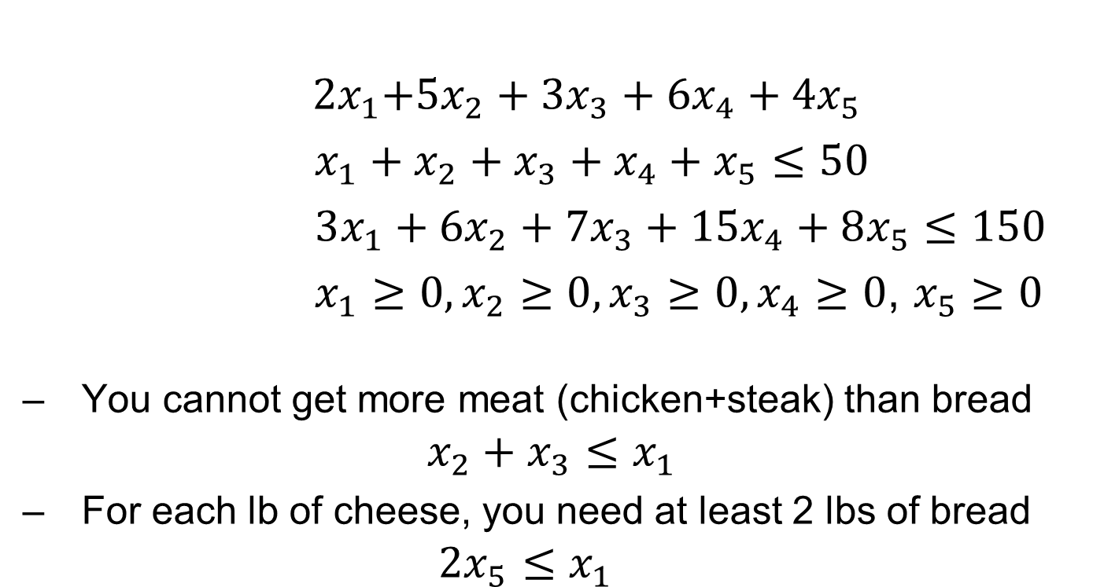

Example 1: Extending the LP
${ 2x}_{1}+{5x}_{2}+{3x}_{3}+{6x}_{4}+{4x}_{5}$
$x_{1}+x_{2}+x_{3}+x_{4}+x_{5}≤50$
$3x_{1}+{6x}_{2}+7x_{3}+15x_{4}+8x_{5}≤150$
$x_{1}≥0, x_{2}≥0,x_{3}≥0, x_{4}≥0$, $x_{5}≥0$
You cannot get more meat (chicken+steak) than bread
$$x_{2}+x_{3}≤x_{1}$$
For each lb of cheese, you need at least 2 lbs of bread
$${2x}_{5}≤x_{1}$$
$$Maximize$$
$$subject to$$

Slide 19
Summary of Formulation Steps
Gather all of your data, know what they mean
Then
Identify your decision variables
Identify your objective and objective function
Identify your constraints
Express your objective function and constraints in terms of your decision variables
Steps 2 and 3 can change order

Slide 20
Case 1: Wyndor Glass Co. Product
Wyndor Glass Co. produces high-quality glass products
The company decides to produce two new products
A glass door with aluminum framing
A wood-framed glass window
The company has 3 plants
Production Time Used for Each Unit Produced
Plant | Doors | Windows | Availability/week
1 | 1 hour | 0 | 4 hours
2 | 0 | 2 hours | 12 hours
3 | 3 hours | 2 hours | 18 hours

Slide 21
Case 1: Wyndor Glass Co. Product
Unit profit for doors is $300
Unit profit for windows is $500
What should be the product mix to maximize profits?
How many of each item to produce weekly?
This is production rate, so it can be continuous, i.e., you can choose to produce 2.5 windows per week (this would be 10 windows per month assuming 4 weeks in a month)

Slide 22
Case 1: Formulating the LP
Step 0: Gather the data (we have it all!)
Step 1: Decision variables
D: the number of doors produced weekly
W: the number of windows produced weekly
Step 2: Define the objective & objective functions
Objective: Maximization
Objective function: Profit=300D+500W
It is the weekly profit

Slide 23
Case 1: Formulating the LP
Step 3: Define the constraints
Plant 1 capacity: D ≤ 4
Plant 2 capacity: 2W ≤ 12
Plant 3 capacity: 3D+2W ≤ 18
Combine what you have!
Maximize 300D+500W
subject to D ≤ 4
2W ≤ 12
3D+2W ≤ 18
D≥0, W ≥0
Do not forget the non-negativity constraints

Slide 24
Outline
Definition of Linear Programming
Formulation of Linear Programming
Surviving in an island
Extending a problem formulation
Wyndor Glass Co. Product Mix Problem
Linear Programming Terminology
Graphical Solution to Linear Programming
Properties of Linear Programming

Slide 25
LP Terminology
Decision Variables: things we control
Objective function: measure of performance
Nonnegativity constraints
Functional constraints: restrictions we have
Parameters: constants we use in the objective function and constraint definitions
Solution: any choice of values for the decision variables
Feasible solution is one that satisfies the constraints
Optimal solution is the best feasible solution

Slide 26

Challenge
Below is a question I was asked during on-site interview with Amazon in Seattle, WA
Suppose you have a set of integer numbers
Formulate an LP that finds the minimum number in this set
Note: your decision variables should be continuous

Slide 27
Outline
Definition of Linear Programming
Formulation of Linear Programming
Surviving in an island
Extending a problem formulation
Wyndor Glass Co. Product Mix Problem
Linear Programming Terminology
Graphical Solution to Linear Programming
Properties of Linear Programming

Slide 28
Graphically Solving Simple LPs
So far we have discussed how to formulate LPs
How about solving them?
Simple LPs can be solved graphically
Simple LP: 2 decision variables!
Graph the constraints to see which points satisfy all constraints (i.e., graph the feasible points)
Graph iso-lines of the objective function (objective function lines)
Use iso-lines to find the optimal solution(s)

Slide 29
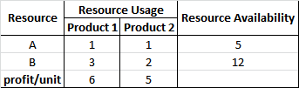
Example 2: Product Mix Problem
Maximize your profit
Decide how many to produce product types 1,2
To be produced, each product requires different amount of 2 resources per unit
Each resource is limited

Slide 30
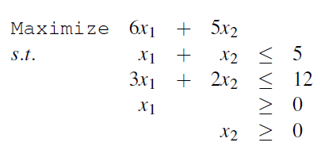
Example 2: LP formulation
You can formulate the following LP model
$x_{1}:the amount of product$ type 1 produced (units)
$x_{2}:the amound ofproduct \text{type}\text{ 2 }\text{produced}$ (units)
Total profit
Resource A limit
Resource B limit
Non-negativity

Slide 31
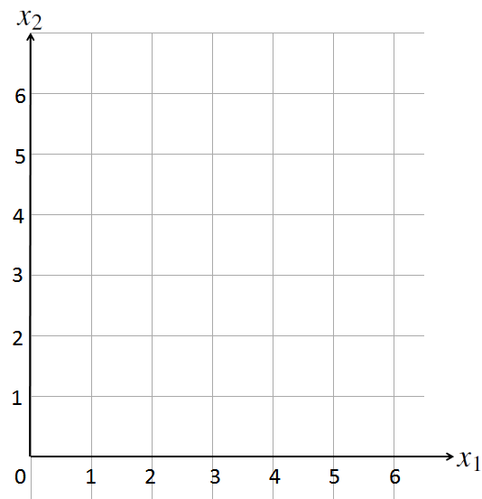
Example 2: Graphical Solution
First, draw your decision variables as the axes of your graph

Slide 32
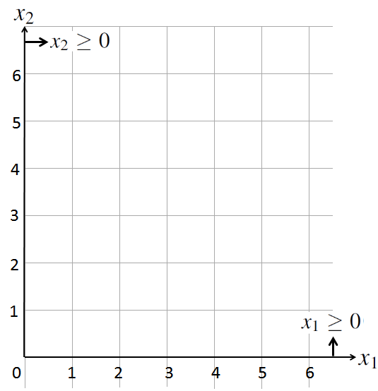

Example 2: Graphical Solution
Start with the easy constraints
Non-negativity constraints!
Assume equality of the constraint ($x_{1}=0$ or $x_{2}=0$ )
Then, find the region defined by the constraint

Slide 33
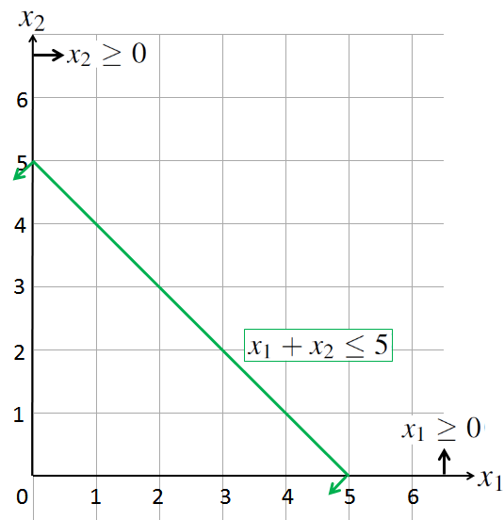
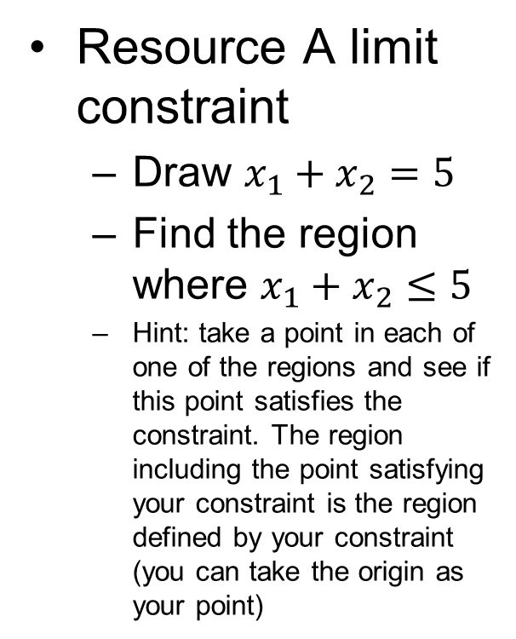
Example 2: Graphical Solution
Resource A limit constraint
Draw $x_{1}+x_{2}=5$
Find the region where $x_{1}+x_{2}≤5$
Hint: take a point in each of one of the regions and see if this point satisfies the constraint. The region including the point satisfying your constraint is the region defined by your constraint (you can take the origin as your point)

Slide 34
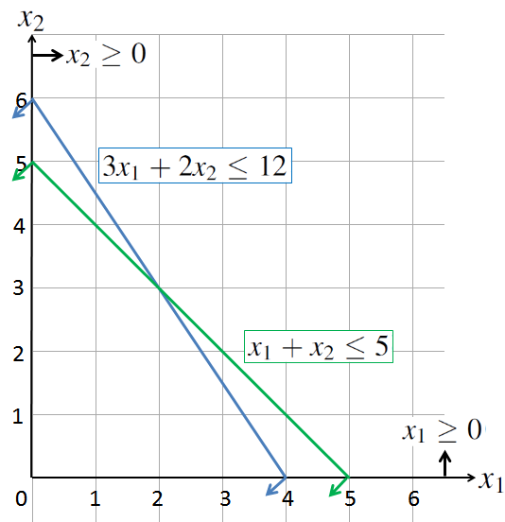
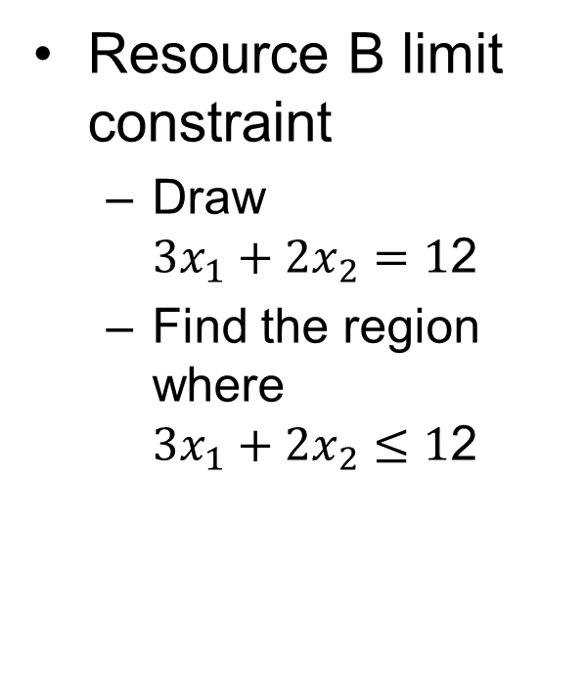
Example 2: Graphical Solution
Resource B limit constraint
Draw ${3x}_{1}+{2x}_{2}=1$2
Find the region where ${3x}_{1}+{2x}_{2}≤1$2

Slide 35
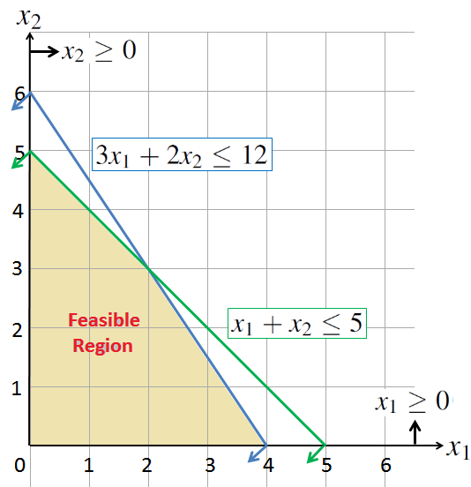
Example 2: Graphical Solution
Define the feasible region
It is the region defined by the intersection of all of your constraints
It includes all of the feasible solutions to your LP

Slide 36
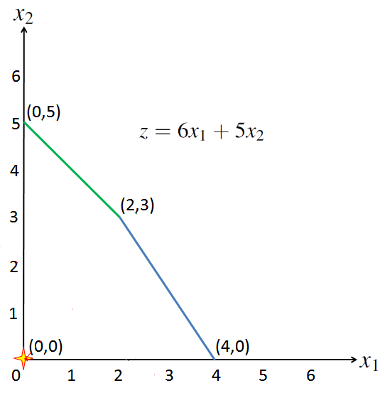



Example 2: Graphical Solution
Improvement Direction

Slide 37
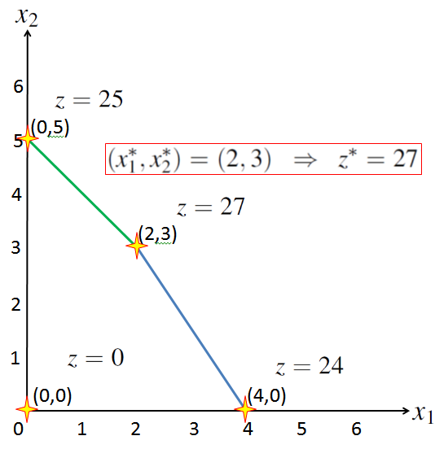
Example 2: Graphical Solution
Optimum solution will be one of the corner solutions!!
Graph the constraints
Define your feasible region
Evaluate the corner points (or draw iso-lines until you leave feasible region)
Choose the best corner point

Slide 38
Graphical Solution to Case 1
Recall the Wyndor Glass Co. Product Mix problem
D: number of doors, W: number of windows
Maximize 300D+500W
subject to D ≤ 4
2W ≤ 12
3D+2W ≤ 18
D≥0, W ≥0
Total profit
Plant 1 availability
Plant 2 availability
Plant 3 availability
Non-negativity

Slide 39
Graphical Solution to Case 1
STEP 1&2: Graph the constraints and find feasible region

Slide 40
Graphical Solution to Case 1
STEP 3: Draw iso-lines to find the optimal solution

Slide 41
Summary of the Graphical Method
Draw the constraint boundary line for each constraint. Use the origin (or any point not on the line) to determine which side of the line is permitted by the constraint.
Find the feasible region by determining where all constraints are satisfied simultaneously.
Determine the slope of one objective function line (iso-line). All other objective function lines will have the same slope.
Move a straight edge with this slope through the feasible region in the direction of improving values of the objective function. Stop at the last instant that the straight edge still passes through a point in the feasible region. This line given by the straight edge is the optimal objective function line.
A feasible point on the optimal objective function line is an optimal solution.

Slide 42
Outline
Definition of Linear Programming
Formulation of Linear Programming
Surviving in an island
Extending a problem formulation
Wyndor Glass Co. Product Mix Problem
Linear Programming Terminology
Graphical Solution to Linear Programming
Properties of Linear Programming

Slide 43
Properties of LPs
An LP problem can have
Infeasibility
No feasible solutions!
Unique optimal solution
Only one feasible solution is optimum
Multiple optimal solutions (alternative optima)
More than one feasible solutions that are optimum
Unboundedness
There is always a better feasible solution

Slide 44
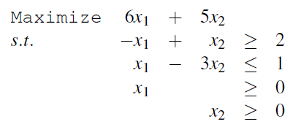
Infeasibility
Consider the following LP problem
Practice: draw the feasible region

Slide 45
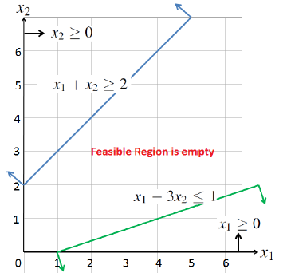
Infeasibility
The feasible region is empty
That is, no solution satisfies the constraints (i.e., there is no feasible solution)
So, no optimal solution exists

Slide 46
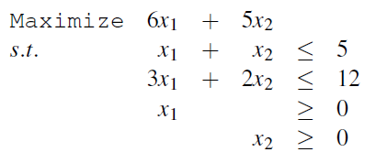
Unique Optimal Solution
Consider the following LP problem (Example 2)

Slide 47
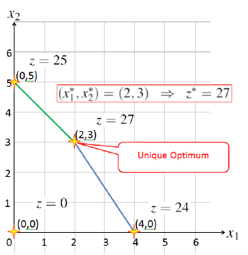
Unique Optimal Solution
The feasible region is not empty
All of the points in the feasible region are feasible solutions
But we have a single optimal solution

Slide 48
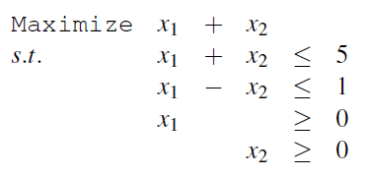
Alternative Optima
Consider the following LP problem

Slide 49
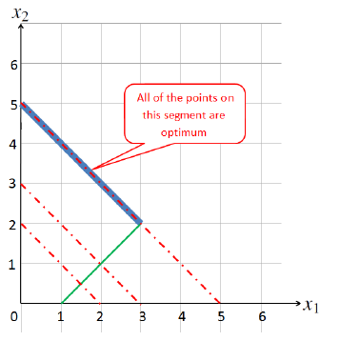

Alternative Optima
The feasible region is not empty
There are many feasible solutions
Also, there are many optimal solutions
but still there are corner points that are also optimum!

Slide 50
Challenge
Does an LP have to have at least two corner solutions that are optimum in case of alternative optima? (I asked this in the Ph.D. qualifying exam)
No!
Proof?
Think about a counter example

Slide 51
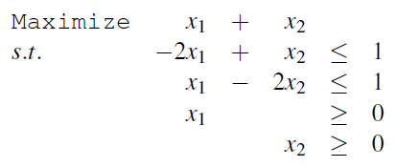
Unboundedness
Consider the following LP problem

Slide 52
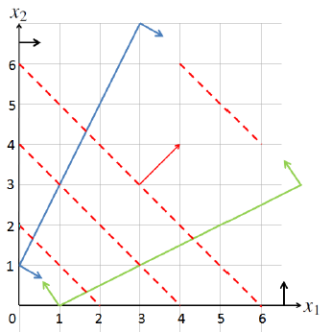
Unboundedness
The feasible region is unbounded and
You can increase the objective function value as much as you can while you are still in the feasible region
Unbounded feasible region does not mean unboundedness of LP

Slide 53
Further Properties of LPs
Given that the constraints do not change
Maximizing 3A+4B = Minimizing -3A-4B
Maximization is opposite of minimization ☺
Maximizing 3A+4B = Maximizing 100+3A+4B
Adding a constant to the objective function does not change the optimum solution, you can just ignore it for optimization
Maximizing 3A+4B = Maximizing 15A+20B
Multiplying all of the coefficients of the objective function with the same positive constant does not change the optimization
On another note, you can multiply both sides of a constraint with the same non-zero constant and it will not change the feasible region, i.e., A+B<= 5 defines the same region with 2A+2B<=10

Slide 54
Further Properties of LPs
Divisibility Assumption of Linear Programming:
Decision variables in a linear programming model are allowed to have any values, including fractional values, that satisfy the functional and nonnegativity constraints. Thus, these variables are not restricted to just integer values.
If violated, you do not have an LP

Slide 55
Further Properties of LPs
LP models are polynomial-ly solvable
That is, they are relatively easy to solve
Simplex Method is a very popular method to solve LP problems
If an optimum solution exists to an LP problem, then there exists an optimum corner solution (this is true for any LP)
Start with a corner solution (extreme point), move to a better corner solution (there are finite corner solutions)
Repeat this until you cannot find a better corner solution
http://en.wikipedia.org/wiki/Simplex_algorithm
Karmarkar’s algorithm and Ellipsoid Method are other ways to solve LP models (wiki them to have a look)

Slide 56
Software for solving LPs
There are many software for solving LPs
They mostly use Simplex type of algorithms
We will learn how to solve simple LPs in Excel
Excel solver uses Simplex Algorithm
Other software
CPLEX (one of the best solvers for LPs)
Matlab has a function to solve LPs (linprog)
Optimization software can solve LPs
GAMS, Xpress, Lindo, Lingo, AMPLE

Slide 57
Next time….
Spreadsheet modeling
Using Excel solver to solve LPs
Applications
Different cases with different LP formulations…
Sensitivity Analysis (briefly)

